Slide 1
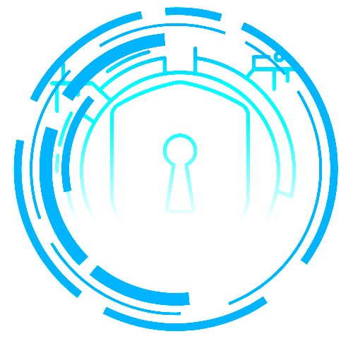

Mzamomtsha Primary School
Website Project Plan
Created By: Tech Loyalties

Slide 2
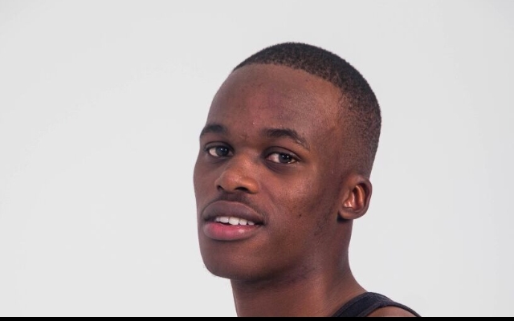
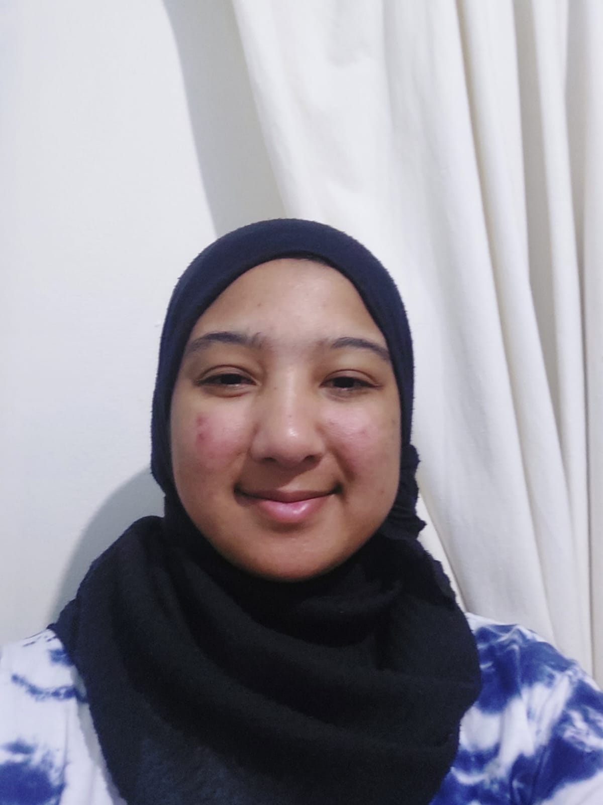
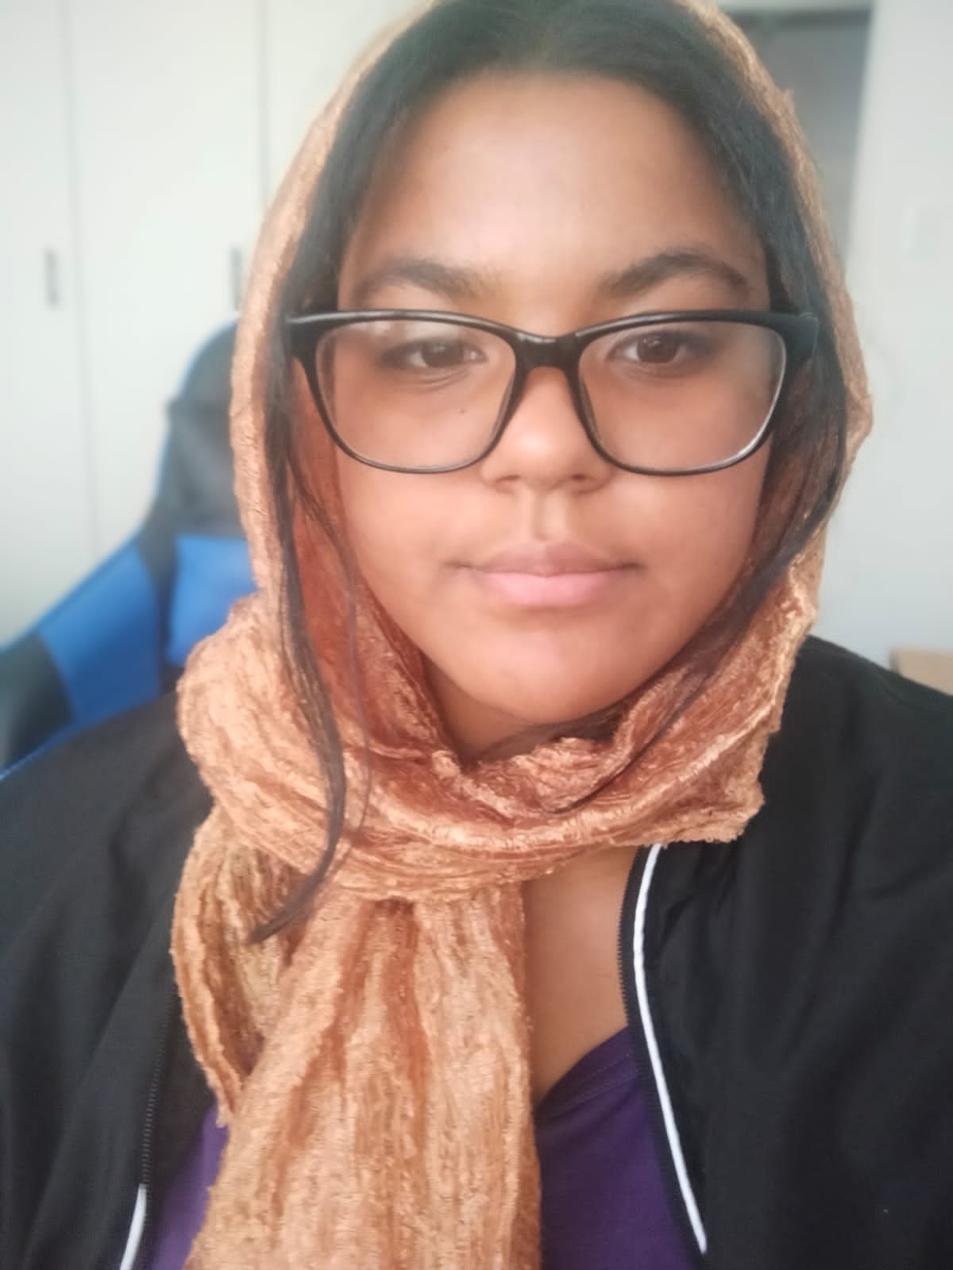
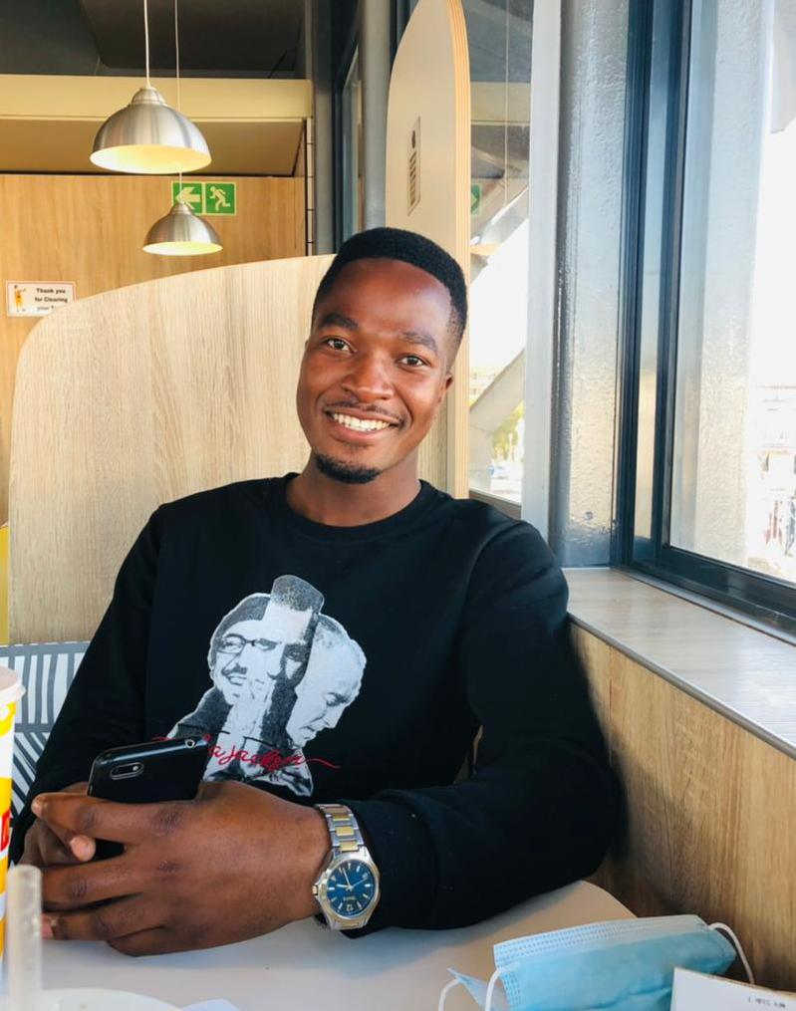
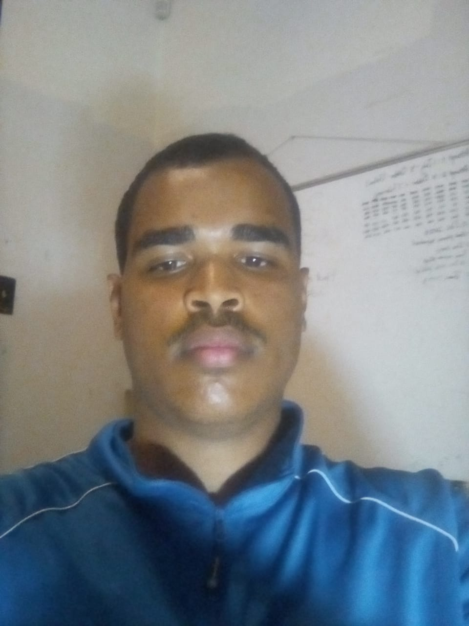
Introducing Members of Tech Loyalties
Hlombe Malandela
Yusrah Safedien
Zainap Van Blerck
Lwazi Mdukulwana
Ryan Goosen

Slide 3
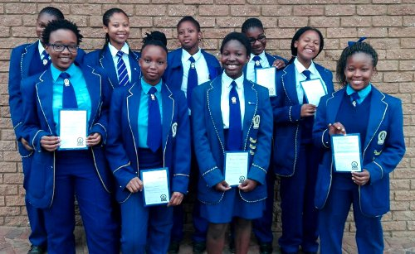
The Mzamomtsha Primary School Background
The Mzamomtsha Primary School Students
Mzamomtsha Primary School is a school in Drifts Sands, an informal settlement between Khayelitsha and Umfuleni township, Western Cape.
The school started with Grade 1-7 and Grade 8-12.
The school wants a website to establish an online presence.
The project will take course over the period of 3 months, February-April 2023.
Tech Loyalties, a software development team, will be developing a website for the school to assist them with promoting themselves online.
The team consists of skilled project manager, quality assurance members, administration, and software developers.

Slide 4
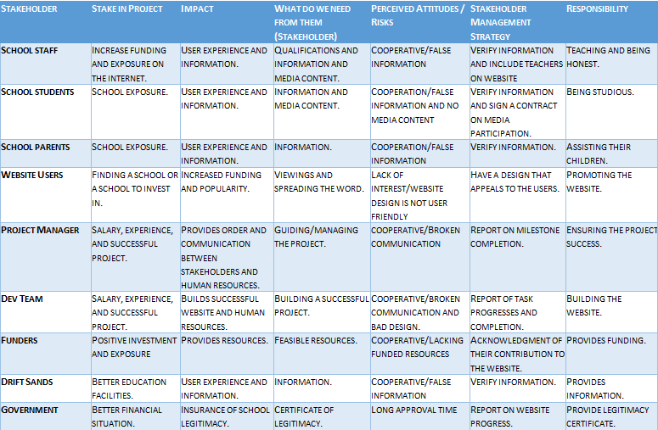
Stakeholder Analysis Report

Slide 5
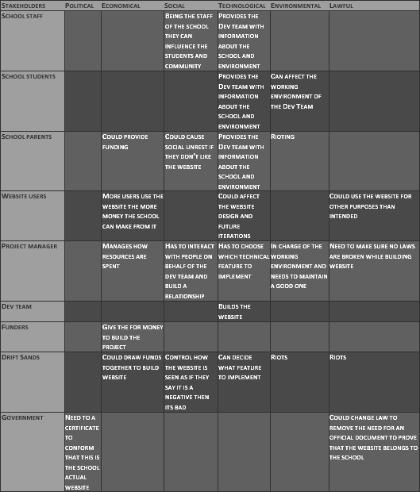
Stakeholder PESTEL

Slide 6
Functional and Non-Functional Requirements
Functional requirements
Home page
Opening page of the website; Allows the user to navigate to other website pages.
About us Page
Details about the school, who they are, where they are located and its owners.
Events Information Page
Displays about all the current events, past events and future events of the school.
Non-Functional requirements
Reliability
expected to be completely functional at least 98% of the time and Down times after failure shall not exceed 24 Hours
Usability
Users are able to locate and view pages in less than 20 seconds.
Performance
Multiple users will be able to access the system without any problems.
Security
Any sensitive information is to be protected and can only be viewed by the owners only.
Supportability
Any search engine should allow users to view the website

Slide 7
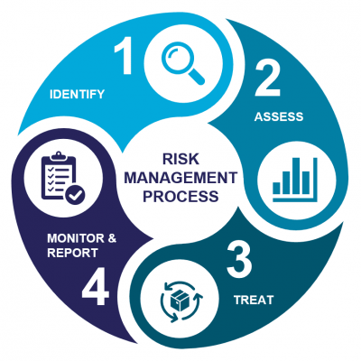
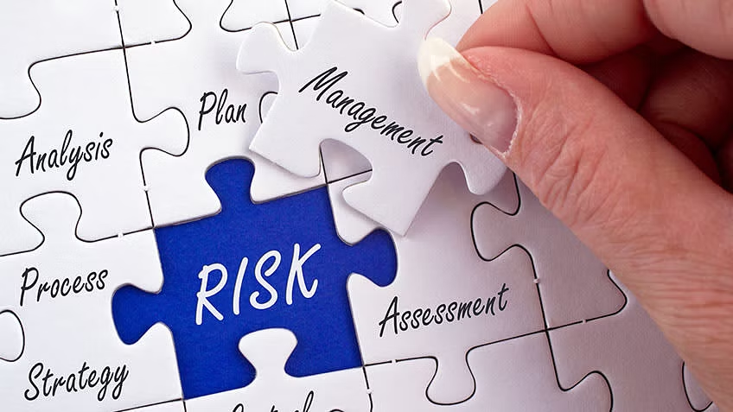
Risk Analysis
Risk | What Can Go Wrong? | Effect | Mitigation Plan
Pages load | Long loading period or pages could not load. | Users will leave the site before viewing it or visit the site less often. | Evaluate the servers for the best option; or have a fun/ aesthetically pleasing loading page.
Page elements' device screen size adjustment | Page content and images may move to awkward or user hindering positions. | Content may become unviewable or users may be unable to navigate the website. | Automated built in functionality to adjust according to screen.
Page elements' window size adjustment | Page content and images may move to awkward or user hindering positions. | Content may become unviewable or users may be unable to navigate the website. | Automated built in functionality to adjust according to screen.
Content change | Client may not know how or may be unable to correctly change website's content. | Website visitors will receive outdated information. | The school will need to consider hiring an external website developer or training a staff in website development to be able to regularly update the website.
User friendly UI | Website may be difficult to navigate and understand. | Users will leave unappealing or hard to navigate websites. | UI will be tested for favorability among users and the website has flexibility for it to be improved at a later date.
Platform repairs | Website platform may have to be shutdown for more complex repairs or updates. | Long periods of website being down can rapidly decrease it's online exposure | Updates to be done in small packages so that the whole website won't need to be shut down and repairs will be quick; one page can be shut down at a time so the whole website won't need to be unavailable

Slide 8
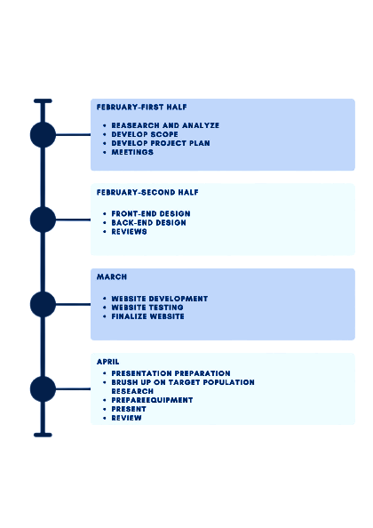

Project Plan

Slide 9
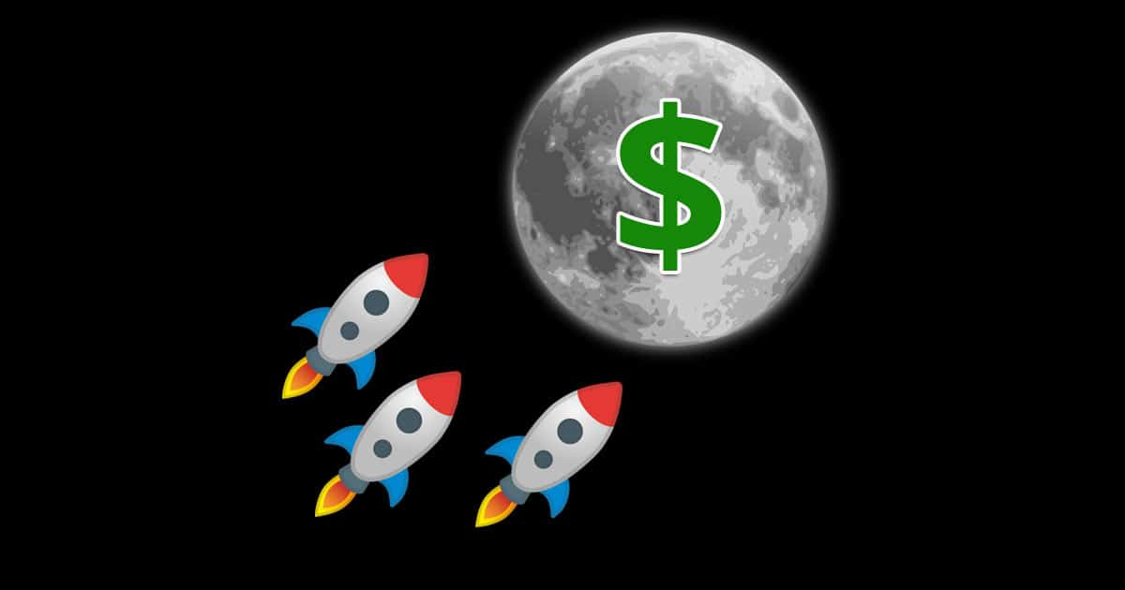


Financial Feasibility Plan
Main Source of Funding: Donation
Goal should be self service
The amount we expect from donations per period R30 000 (small bills)
The amount of upfront capital drawn from local business R50 000 (they make R500 a day)
The amount expended on the domain name, protection services and hosting R378 a year
If we get all the funding we have enough capital to run the website for 2 centuries and still have some to cash to spare.
Notes:
The main sources of funding will come from donations which isn't a place any company want to be, for who know when the generosity of your fellow man will dry up. So to avoid this the main goal of our website is to be self sustainability. How, well we all know how advertisers love your data, who wouldn't want to sell cheap knock off nikes to some of the poorest people in africa. Plus ads, who doesn't like a few ads here and there. So when it come to our first round and hopefully only round of funding I calculated that we can expect around R30 000 in cash over a period of 3 month with the majority of it being small bills. Since the majority of people earn around R1 to R1600 a month, with a minimum of 3000 in drift sands and another 140000 people in the surrounding area, the estimated amount is truely a minimum. Another sources of funding will be investment from local businesses in the area which could be entice with the opportunity to grow their businesses, the amount is calculated at around R50 000 this is a complete guess as we do not know how many businesses there are in the area but it seems feasible with how heavy the government is investing in the area. Lastly we have the government of the Republic of South Africa, we expected a maximum of R0, dont ever expect money from the government. So that leaves us with upfront capital of R80 000. Our expenses tally up to a maximum of R387.00 a year, this is for the web hosting, domain name and protection services. The lovely dev team will not be paid for this venture nor will they receive performance bonuses as it is an honour for them to serve such a underfunded community. As well as they lack the experience to justify them getting a penny..If we do the calculations the capital should last them for around 2 centuries unless there is some corruption involved. Which well this is South Africa after all.

Slide 10
Thank You!
Any Questions?
Notes:
In short our main goal is to give this underfunded school a leg up in the world with a digital presence. With a smooth, clean, fast website loaded with needed information to give the user a reason to come back again. Making them eventually stand toe to toe with giants like PAARL BOYS HIGH. Secondary goal is to give the school a second stream of income to fund extra project for the school. And the personal goals for this dev team is to get some much needed job experience because they don't wanna be unpaid interns forever.

